Slide 1
Chapter 8: Single-Area OSPF
Chapter 5
Routing & Switching
Notes:
Cisco Networking Academy program
Routing Protocols
Chapter 8

Slide 2
Outline
Characteristics of OSPF
Configuring Single-area OSPFv2
Configure Single-area OSPFv3
Notes:
Chapter 8

Slide 3
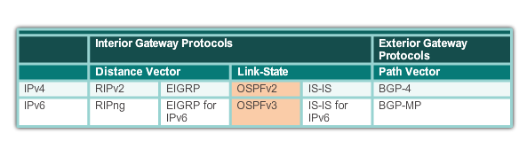
Open Shortest Path First
Evolution of OSPF
Interior Gateway Protocols
1989
updated in 2008
1988
Notes:
8.1.1.1 Evolution of OSPF

Slide 4
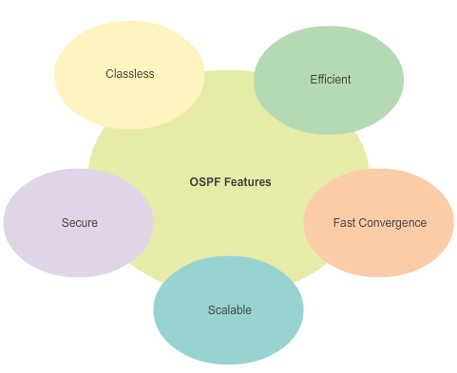
Open Shortest Path First
Features of OSPF
Notes:
8.1.1.2 Features of OSPF

Slide 5
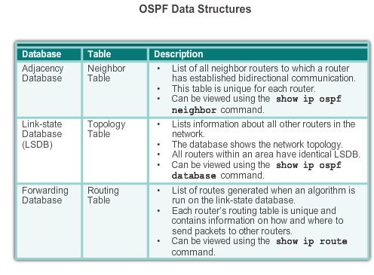
Open Shortest Path First
Components of OSPF
Notes:
8.1.1.3 Components of OSPF

Slide 6
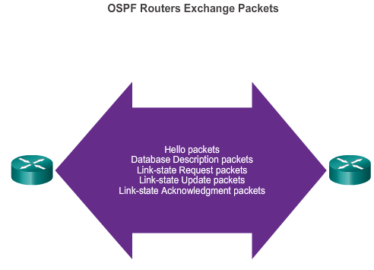
Open Shortest Path First
Components of OSPF (cont.)
OSPF Routers Exchange Packets - These packets are used
To discover neighboring routers
To exchange routing information
To maintain accurate information about the network.
Notes:
8.1.1.3 Components of OSPF (cont.)

Slide 7
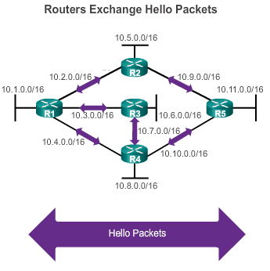
Open Shortest Path First
Link-State Operation
If a neighbor is present, the OSPF-enabled router attempts to establish a neighbor adjacency with that neighbor
Notes:
8.1.1.4 Link-State Operation

Slide 8
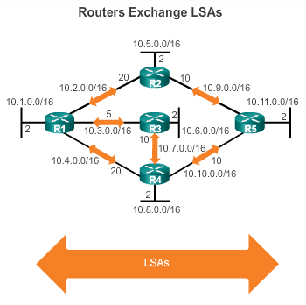
Open Shortest Path First
Link-State Operation (cont.)
LSAs contain the state and cost of each directly connected link.
Routers flood their LSAs to adjacent neighbors.
Adjacent neighbors receiving the LSA immediately flood the LSA to other directly connected neighbors, until all routers in the area have all LSAs.
Notes:
8.1.1.4 Link-State Operation (cont.)

Slide 9
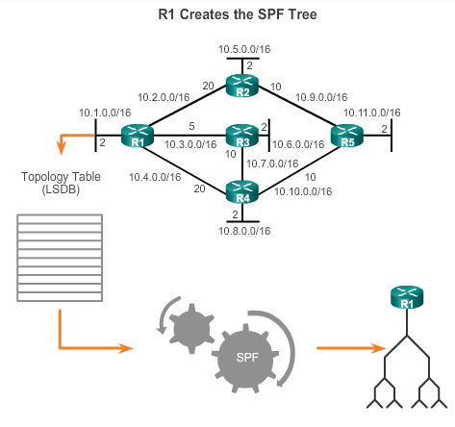
Open Shortest Path First
Link-State Operation
Build the topology table based on the received LSAs.
This database eventually holds all the information about the topology of the network.
Execute the SPF Algorithm.
Notes:
8.1.1.4 Link-State Operation (cont.)

Slide 10
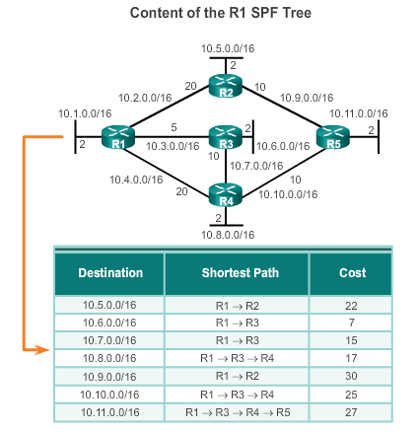
Open Shortest Path First
Link-State Operation (cont.)
From the SPF tree, the best paths are inserted into the routing table.
Notes:
8.1.1.4 Link-State Operation (cont.)

Slide 11
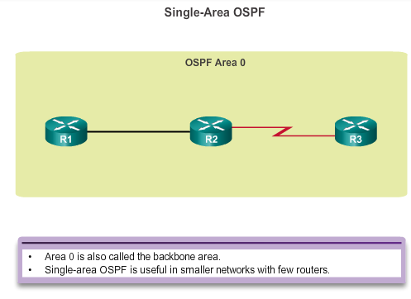
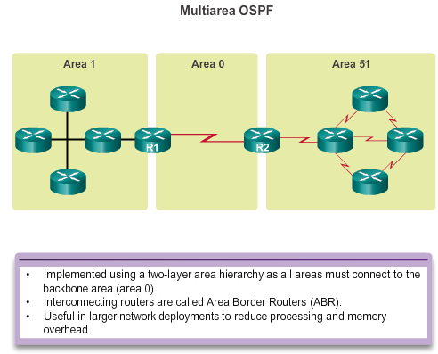
Open Shortest Path First
Single-area and Multiarea OSPF
Notes:
8.1.1.5 Single-Area and Multiarea OSPF

Slide 12
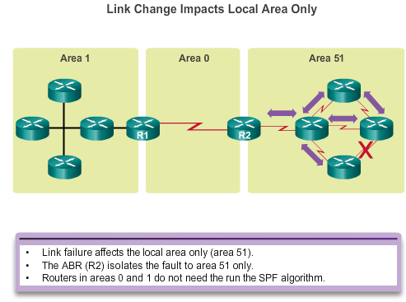
Open Shortest Path First
Single-area and Multiarea OSPF (cont.)
Notes:
8.1.1.5 Single-Area and Multiarea OSPF (cont.)

Slide 13
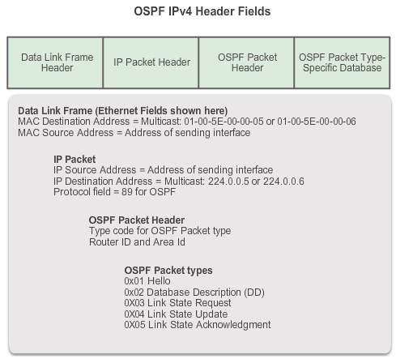
OSPF Messages
Encapsulating OSPF Messages
Notes:
8.1.2.1 Encapsulating OSPF Messages

Slide 14
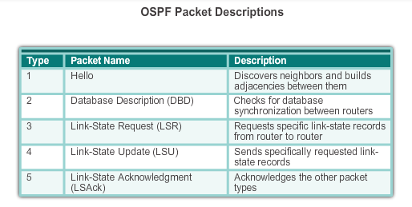
OSPF Messages
Types of OSPF Packets
Notes:
8.1.2.2 Types of OSPF Packets

Slide 15
OSPF Messages
Hello Packet
OSPF Type 1 packet = Hello packet:
Discover OSPF neighbors and establish neighbor adjacencies.
Advertise parameters on which two routers must agree to become neighbors.
Elect the Designated Router (DR) and Backup Designated Router (BDR) on multiaccess networks like Ethernet and Frame Relay.
Notes:
8.1.2.3 Hello Packet

Slide 16
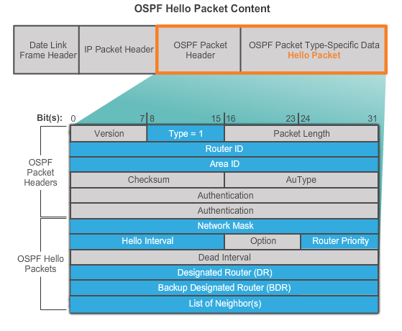
OSPF Messages
Hello Packet (cont.)
Notes:
8.1.2.3 Hello Packet (cont.)

Slide 17
OSPF Messages
Hello Packet Intervals
OSPF Hello packets are transmitted:
To 224.0.0.5 in IPv4 and FF02::5 in IPv6 (all OSPF routers)
Every 10 seconds (default on multiaccess and point-to-point networks)
Every 30 seconds (default on non-broadcast multiaccess [NBMA] networks)
Dead interval is the period that the router waits to receive a Hello packet before declaring the neighbor down
Router floods the LSDB with information about down neighbors out all OSPF enabled interfaces
Notes:
8.1.2.4 Hello Packet Intervals (cont.)

Slide 18
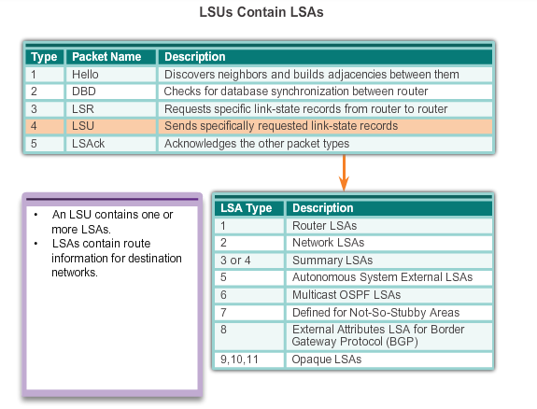
OSPF Messages
Link-State Updates
Notes:
8.1.2.5 Link-State Updates

Slide 19
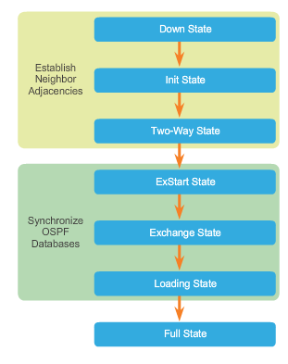
OSPF Operation
OSPF Operational States
When an OSPF router is initially connected to a network, it attempts to:
Create adjacencies with neighbors
Exchange routing information
Calculate the best routes
Reach convergence
OSPF progresses through several states while attempting to reach convergence.
Notes:
8.1.3.1 OSPF Operational States

Slide 20
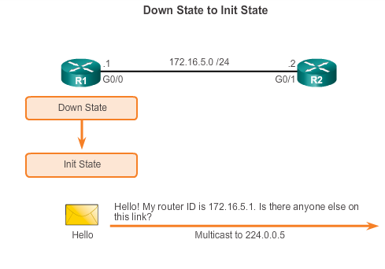
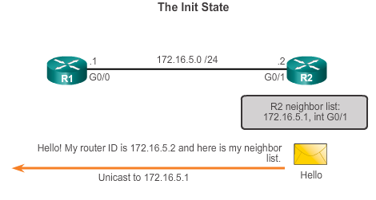
OSPF Operation
Establish Neighbor Adjacencies
Notes:
8.1.3.2 Establish Neighbor Adjacencies

Slide 21
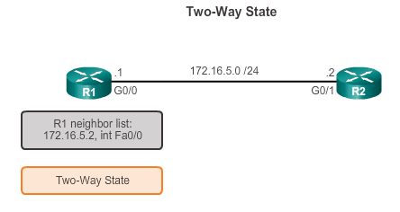
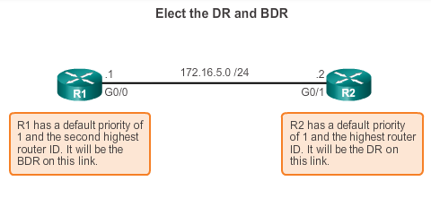
OSPF Operation
Establish Neighbor Adjacencies (cont.)
DR and BDR election only occurs on multi-access networks such as Ethernet LANs.
Notes:
8.1.3.2 Establish Neighbor Adjacencies (cont.)

Slide 22
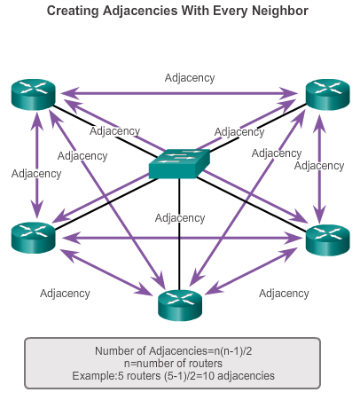
OSPF Operation
OSPF DR and BDR
Notes:
8.1.3.3 OSPF DR and BDR

Slide 23
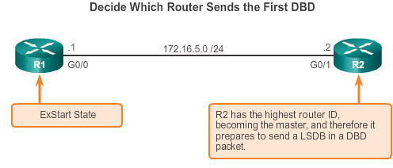
OSPF Operation
Synchronizing OSPF Database
Notes:
8.1.3.4 Synchronizing OSPF Databases

Slide 24
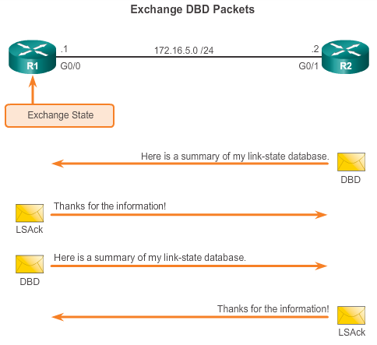
OSPF Operation
Synchronizing OSPF Database (cont.)
Notes:
8.1.3.4 Synchronizing OSPF Databases

Slide 25
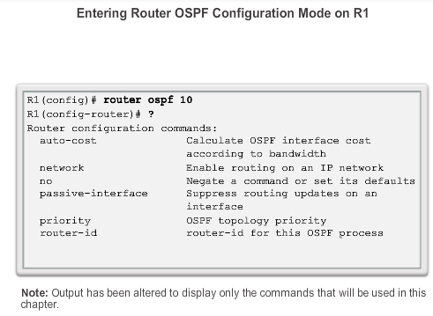
OSPF Router ID
OSPF Network Topology
Notes:
8.2.1.2 Router OSPF Configuration Mode

Slide 26
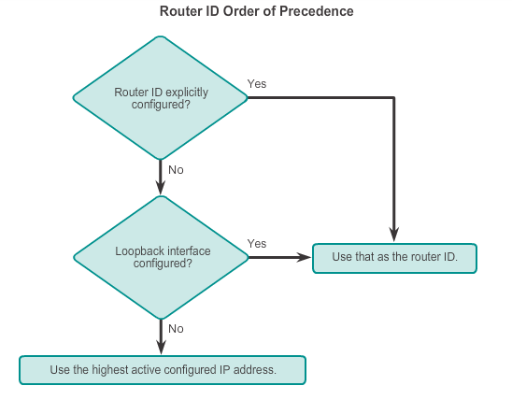
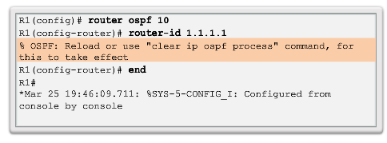
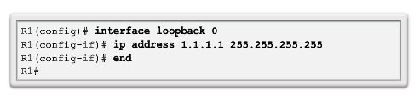
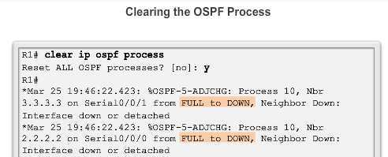
OSPF Router ID
Router IDs
Notes:
8.2.1.3 Router IDs
8.2.1.4 Configuring an OSPF Router ID
8.2.1.5 Modifying a Router ID
8.2.1.6 Using a Loopback Interface as the Router ID

Slide 27
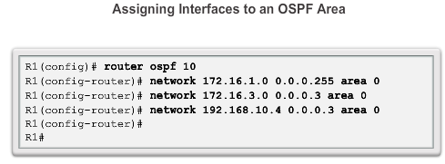
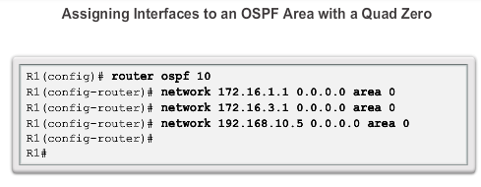
Configure Single-area OSPFv2
The network Command
Notes:
8.2.2.1 Enabling OSPF on Interfaces
8.2.2.2 Wildcard Mask
8.2.2.3 The network Command

Slide 28
Configure Single-Area OSPFv2
Passive Interface
By default, OSPF messages are forwarded out all OSPF-enabled interfaces. However, these messages really only need to be sent out interfaces connecting to other OSPF-enabled routers.
Sending out unneeded messages on a LAN affects the network in three ways:
  Inefficient Use of Bandwidth
  Inefficient Use of Resources
  Increased Security Risk
The Passive Interface feature helps limiting the scope of routing updates advertisements.
Notes:
8.2.2.4 Passive Interface

Slide 29
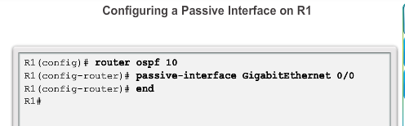
Configure Single-area OSPFv2
Configuring Passive Interfaces
Use the passive-interface router configuration mode command to prevent the transmission of routing messages through a router interface, but still allow that network to be advertised to other routers.
Notes:
8.2.2.5 Configuring Passive Interfaces

Slide 30
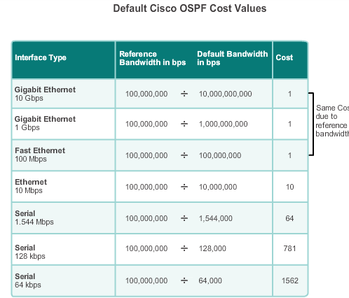
OSPF Cost
OSPF Metric = Cost
Cost = reference bandwidth / interface bandwidth
(default reference bandwidth is 10^8)
Cost = 100,000,000 bps / interface bandwidth in bps
Notes:
8.2.3.1 OSPF Metric = Cost

Slide 31
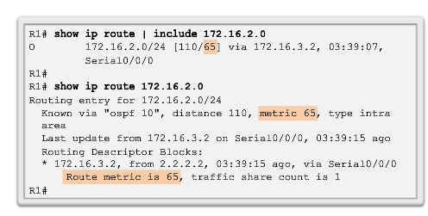
OSPF Cost
OSPF Accumulates Costs
Cost of an OSPF route is the accumulated value from one router to the destination network.
Notes:
8.2.3.2 OSPF Accumulates Costs

Slide 32
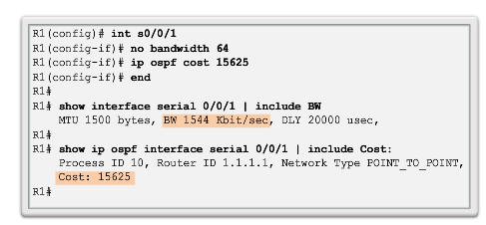
OSPF Cost
Manually Setting the OSPF Cost
Both the bandwidth interface command and the ip ospf cost interface command achieve the same result, which is to provide an accurate value for use by OSPF in determining the best route.
Notes:
8.2.3.6 Manually Setting the OSPF Cost

Slide 33
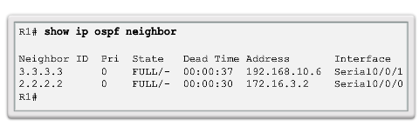
Verify OSPF
Verify OSPF Neighbors
Verify that the router has formed an adjacency with its neighboring routers.
Notes:
8.2.4.1 Verify OSPF Neighbors

Slide 34
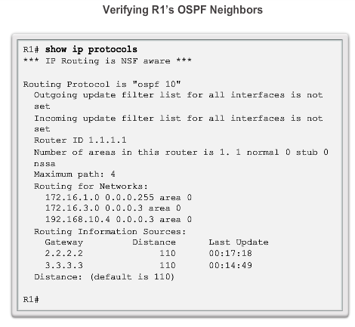
Verify OSPF
Verify OSPF Protocol Settings
Notes:
8.2.4.2 Verify OSPF Protocol Settings

Slide 35
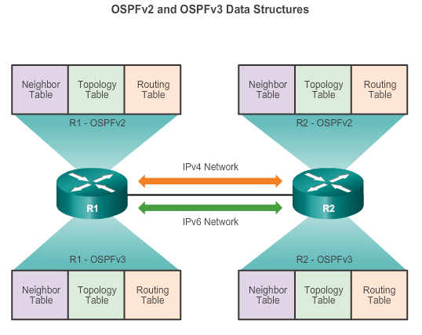
OSPFv2 vs. OSPFv3
OSPFv3
Notes:
8.3.1.1 OSPFv3

Slide 36
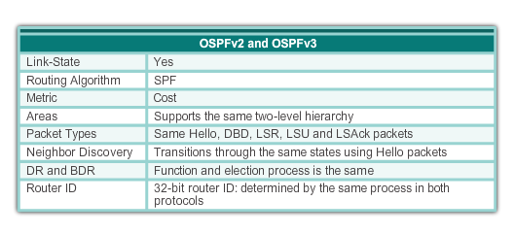
OSPFv2 vs. OSPFv3
Similarities Between OSPFv2 to OSPFv3
Notes:
8.3.1.2 Similarities Between OSPFv2 to OSPFv3

Slide 37
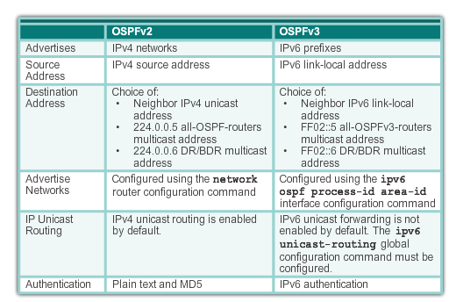
OSPFv2 vs. OSPFv3
Differences Between OSPFv2 to OSPFv3
Notes:
8.3.1.3 Differences Between OSPFv2 and OSPFv3

Slide 38
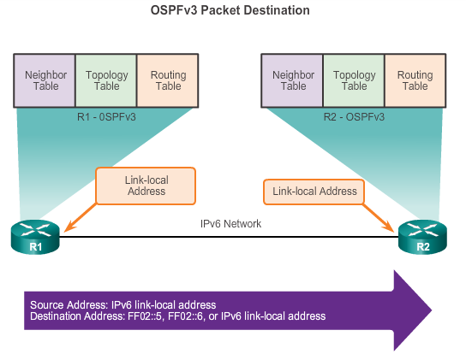
OSPFv2 vs. OSPFv3
Link-Local Addresses
FF02::5 address is the all OSPF router address
FF02::6 is the DR/BDR multicast address
Notes:
8.3.1.4 Link-Local Addresses

Slide 39
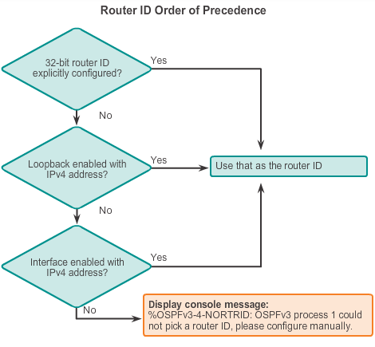
Configuring OSFPv3
Configuring the OSPFv3 Router ID
Notes:
8.3.2.4 Configuring the OSPFv3 Router ID

Slide 40
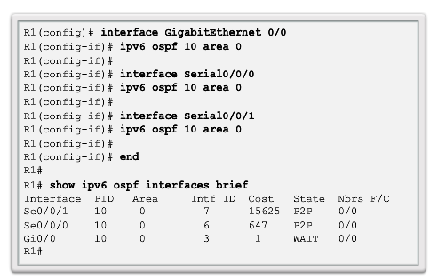
OSPF Configuring OSFPv3
Enabling OSPFv3 on Interfaces
Instead of using the network router configuration mode command to specify matching interface addresses, OSPFv3 is configured directly on the interface.
Notes:
8.3.2.6 Enabling OSPFv3 on Interfaces

Slide 41
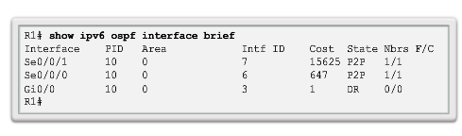
Verify OSPFv3
Verify OSPFv3 Interfaces
Notes:
8.3.3.3 Verify OSPFv3 Interfaces

